Slide 1

Fundamentals of data representation
Lesson
Huffman coding

Slide 2
Learning objectives – Be able to
Analyse some plain ASCII text to determine frequency of specific characters
Transform uncompressed ASCII text to a compressed format using Huffman Coding Methodology
Convert compressed text into ASCII characters using a given Huffman tree
Describe where Huffman coding provides optimal benefits

Slide 3
How often do different characters occur in text?
This method works by recording the frequencies by which characters appear in text.
Some characters appear far more often than others.
Which do you think occur most frequently?
How about less frequently?
Notes:
Optional – demonstrate the different frequencies of different characters using your own document – the longer the better.

Slide 4
Focus on Huffman coding
There are two steps when using Huffman’s technique:
Create a Huffman tree – this gives each character used a unique code.
Encode the character sequence into a binary stream.
https://youtu.be/Ql18aET1G1w

Slide 5
Huffman coding – worked example
Look at this sentence:
an easy example
What do you notice?
Notes:
For the sake of simplicity we have chosen an example where there are only letters present and there are no capital letters used or any other punctuation. We must however take note of spaces.

Slide 6
Huffman coding – worked example
Now create a table showing the frequency of occurrence for each character.
an easy example
Character | Frequency | Character | Frequency
a | 3 | p | 1
e | 3 | s | 1
l | 1 | x | 1
m | 1 | y | 1
n | 1 | space | 2
Click to reveal
Click to reveal
Notes:
We only need to show characters that are actually present.

Slide 7
Huffman coding – worked example
Now we need to create the graphical node representation used by the Huffman method.
To begin this process, we have to start with the lowest frequencies at the top of the list – the actual alphabetical order does not matter.
The Huffman tree generated allows you to assign a unique code to each character used.
The wider the range of characters used, the bigger the Huffman tree!

Slide 8
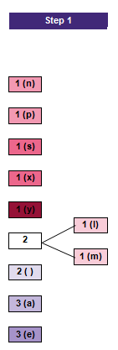
Huffman coding – worked example
At the start, the characters are placed in order of occurrence, from top to bottom. Where the frequency is the same, the order does not matter.
( ) indicates the space character.
Step 1
The top two entries’ frequencies are added together and a new node is inserted.
Notes:
Please note – for each step you are asked to refer to the separate printed notes for this exercise, the diagrams used here are reproduced from there.

Slide 9
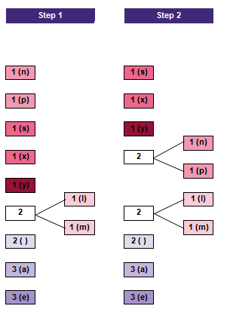
Huffman coding – worked example
Step 2
Same as Step 1 with 1 (n) and 1 (p).

Slide 10
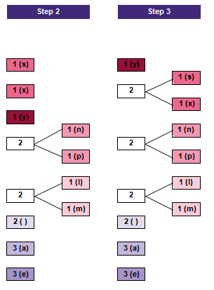
Huffman coding – worked example
Step 3
Same as Step 2 with 1 (s) and 1 (x).

Slide 11
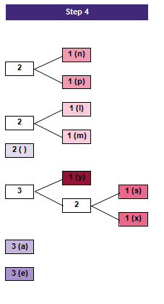
Huffman coding – worked example
Step 4
Look what happens to 1 (y).

Slide 12
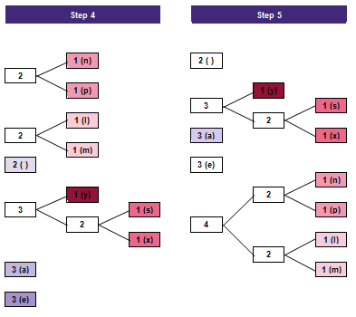
Huffman coding – worked example
Step 5
The top two nodes combine and move to the end of the list as to their combined value exceeds that of the other elements.

Slide 13
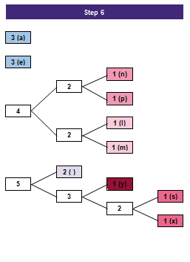
Huffman coding – worked example
Step 6
The pattern continues…

Slide 14
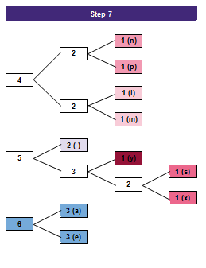
Huffman coding – worked example
Step 7
More of the same…

Slide 15
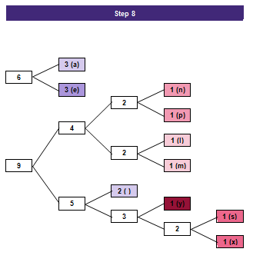
Huffman coding – worked example
Step 8
The objective is to end up with one single node.

Slide 16
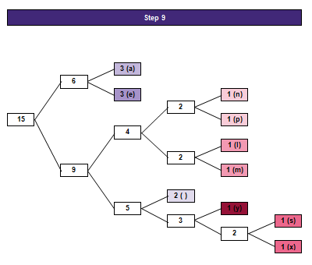
Huffman coding – worked example
Step 9
We made it!
The value of the left-hand node should be equal to the number of characters in the original string.
an easy example = 15 characters
Success!

Slide 17
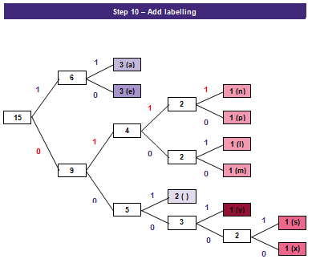
Huffman coding – worked example
Step 10
Put ‘1’ on the upward directions and ‘0’ on the downward directions.
How would we denote the ‘n’?
Down one, up one, up one, up one = 0111

Slide 18
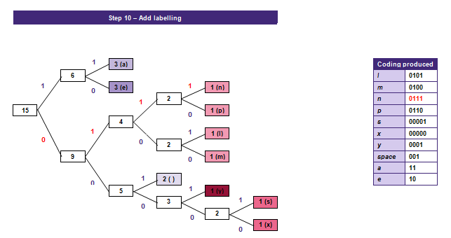
Huffman coding – worked example

Slide 19
Huffman coding – worked example
a | n |  | e | a | s | y |  | e | x | a | m | p | l | e
11 |  |  |  | 11 |  |  |  |  |  | 11
 |  |  | 10 |  |  |  |  | 10 |  |  |  |  |  | 10
 |  | 001 |  |  |  |  | 001
 |  |  |  |  |  |  |  |  |  |  | 0100
 |  |  |  |  |  |  |  |  |  |  |  | 0110
 |  |  |  |  |  | 0001
 |  |  |  |  |  |  |  |  |  |  |  |  | 0101
 | 0111
 |  |  |  |  | 00001
 |  |  |  |  |  |  |  |  | 00000
Full binary representation = 11 0111 001 10 11 00001 0001 001 10 00000 11 0100 0110 0101 10

Slide 20
Decoding with the Huffman method – worked example
Our encoded text would be received as follows…
110111001101100001000100110000001101000110010110
You must be in possession of the Huffman tree to decode the text!
Notes:
Given that we have seen how to create the Huffman tree which of course gives us the binary encoding scheme specific to the text it is being used to compress, it is of course important to show how this may be used to recover the text from its binary encoding.

Slide 21
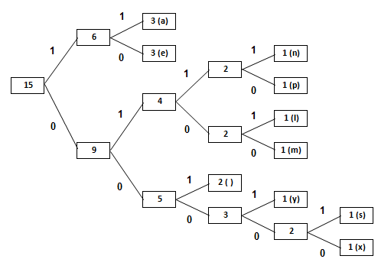
Decoding with the Huffman method – worked example
First character
Start at beginning of string and follow binary until it terminates:
110111001101100001000100110000001101000110010110
Following ‘1’ then ‘1’ takes us to a.

Slide 22
Decoding with the Huffman method – worked example
Second character
Move to the next set of digits:
110111001101100001000100110000001101000110010110
= an

Slide 23
Decoding with the Huffman method – worked example
Third character
Continue the previous process – this time we find a space character…
110111001101100001000100110000001101000110010110
= an

Slide 24
Decoding with the Huffman method – worked example
Fourth character
110111001101100001000100110000001101000110010110
= an e
Continue until no binary digits remain.

Slide 25
Huffman coding – conclusion
Look at the table.
You can see that the characters at the top generally:
appear most frequently
have short binary representations.
This is the advantage of Huffman coding.
l | 0101
m | 0100
n | 0111
p | 0110
s | 00001
x | 00000
y | 0001
space | 001
a | 11
e | 10
If conventional ASCII uses eight bits to represent a character. Huffman coding can reduce that to as little as two bits.

Slide 26
Huffman coding – conclusion
Note: Huffman coding method will incur some ‘overhead’ when used.
What do you think this is?
It is necessary to transmit a representation of the encoding ‘tree’ along with the encoded data. Each Huffman tree is unique as it is dependent upon the piece of text which it used to encode.
The Huffman method works best when there is a good distribution of frequently occurring ‘common’ characters.

